Slide 1
Propositional Logic

Slide 2
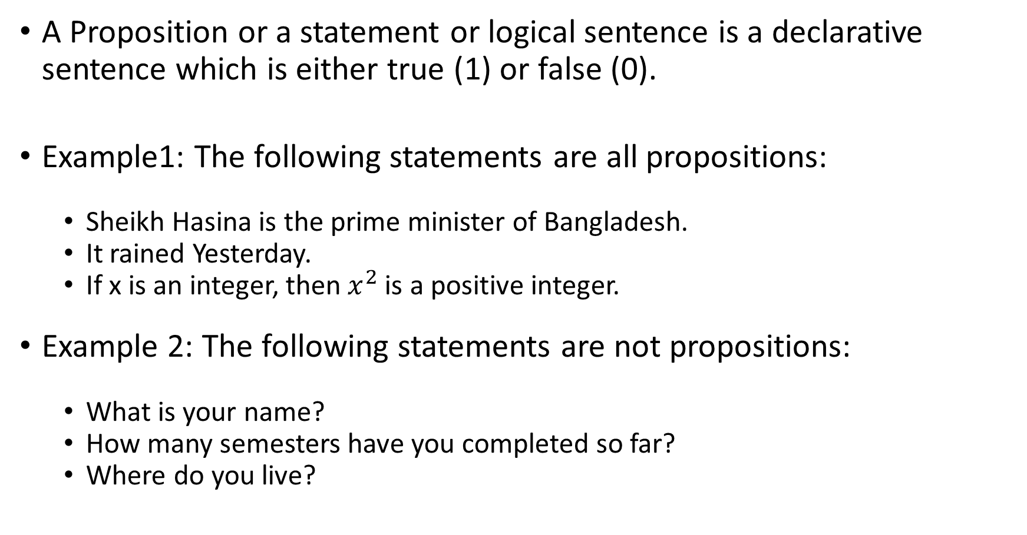
What is a proposition?
A Proposition or a statement or logical sentence is a declarative sentence which is either true (1) or false (0).
Example1: The following statements are all propositions:
Sheikh Hasina is the prime minister of Bangladesh.
It rained Yesterday.
If x is an integer, then $x^{2}$ is a positive integer.
Example 2: The following statements are not propositions:
What is your name?
How many semesters have you completed so far?
Where do you live?

Slide 3
Propositional Variables
The letters used to present a proposition is called a variable. Normally we use English letters for example P, Q, R and so on as propositional variables.
Example:
P: Bangladesh is in Asia
Q: 2 + 2 = 4
R: 3+2 = 6
Problem 1: Store the following propositions in propositional variables.
It is Monday today
The sky is blue
This is discrete mathematics class

Slide 4
Compound Statements
A compound statement is a sentence that consists of two or more statements separated by logical connectors.
Statements or propositional variables can be combined by means of logical connectives (operators) to form a single statement called compound statements.

Slide 5
Logical Connectives
The five logical connectives are:
Symbol | Connective | Name
~ | Not | Negation
∧ | And | Conjunction
∨ | Or | Disjunction
⟶ | Implies or if...then | Implication or conditional
⟷ | If and only if | Equivalence or biconditional
Example: It is Monday today AND it rained yesterday

Slide 6
Suggested Questions
What are the differences between simple propositional statement and compound propositional statements?
How can we create compound propositional statements from simple propositional statements?
Identifying simple and compound statements.

